Slide 1

Who wants to be a millionaire
MOUNIKA KODURI (Group leader)
JASMIKA VEMULAPALLI
WEB PROGRAMMING SPRING 2023
PROJECT 2

Slide 2
PROBLEM STATEMENT
“Who wants to be a Millionaire?” – A game where players answer multiple-choice questions from a variety of genres in an effort to earn enormous financial rewards and demonstrate their level of knowledge.
An online application built using three widely used language in web programming
HTML & CSS (Front end – UI)
PHP (Back end – structure/algorithm)
Prize money increases after every round/question. No time limit either.
Questions become challenging as the player advances in the game. The top cash reward of $1M is awarded in the championship round.
The game will depart the player with the monetary prize they received in the previous round if they provide an incorrect answer to a question.
A leaderboard with a list of all the participants and their scores is also displayed on the website.
The leaderboard will rank them according to the highest scorer, and the scores show how many of the questions they answered correctly.

Slide 3
REQUIREMENTS (Input)
When a user registers on the website, information about the user, such as their username and password, is collected.
For each round, questions from a variety of genres.
Amount that will be awarded for finishing each round.
Each round will result in a score being assigned.

Slide 4
REQUIREMENTS(Output)
Maintain user information in an output user file, including username, password, score, and any cash prizes won.
Display to the user their winnings in money after each round.
Every time a user plays a game, the score and money prize they have received are updated in their user file.
Leaderboard displays top 5 players with highest scores

Slide 5
DESIGN
Sessions
When a user logs in, the user's session is maintained based on username and password. A session ends only when the user logs out of the website.
Processing the Forms
Each question utilizes the forms. The form sends the answer through PHP and returns the result of correct or incorrect. If correct then continue, otherwise, they will be eliminated from the game.
Score will get updated after each question so we can have a track of which user scored how many points and can determine their winning amount.
UI

Slide 6
TESTING
Check for link connections
Fetch user data from the txt file
Answer validation for each question
Score and prize update simultaneously
Sessions

Slide 7
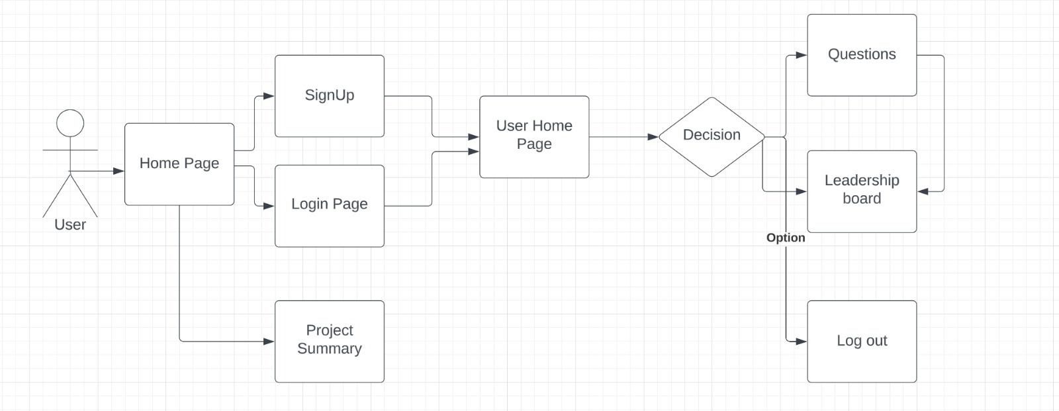
UML DIAGRAM

Slide 8
SCRUM METHODOLOGY
Scrum Methodology helped us in visualizing the order of the tasks to be performed.
It helped us divide tasks among ourselves and integrating became easy since everything is organized.
It felt easier to resolve errors which saved a lot of time.
Targets at each point made us understand if we would finish the project within the given time frame.

Slide 9
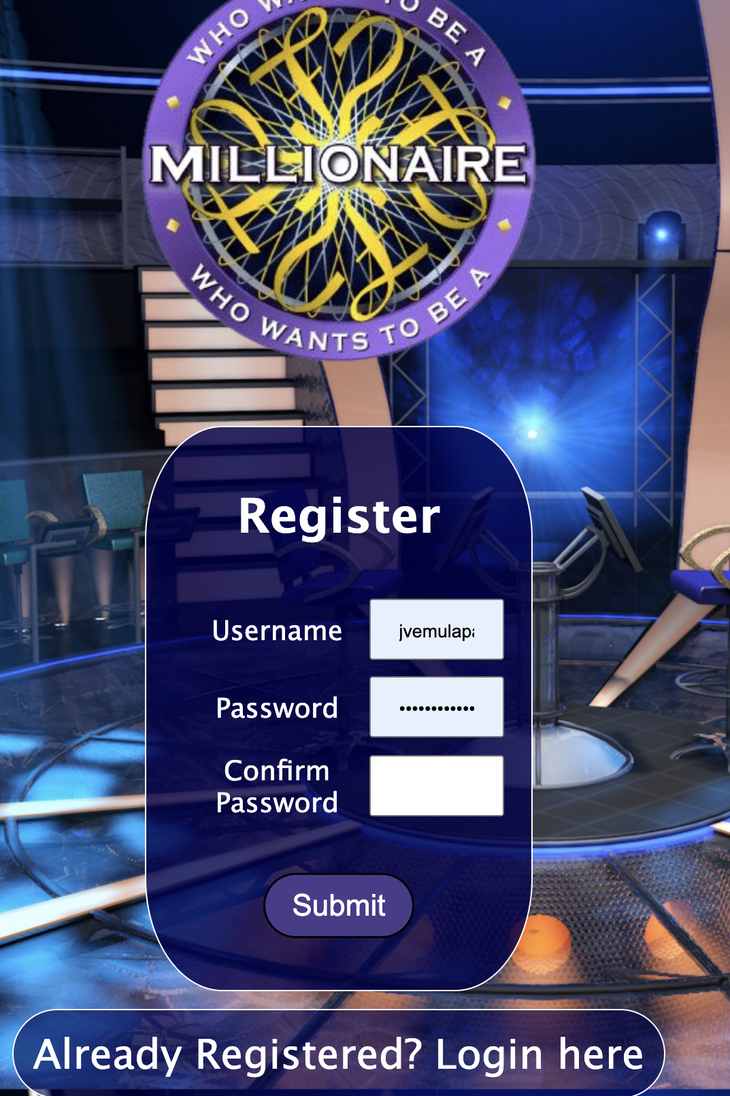
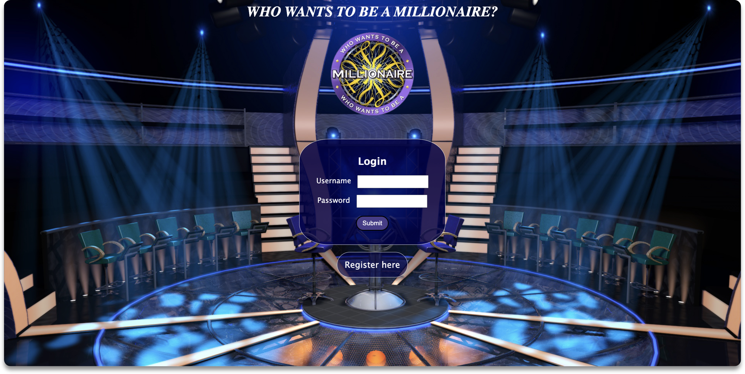
USER INTERFACE

Slide 10
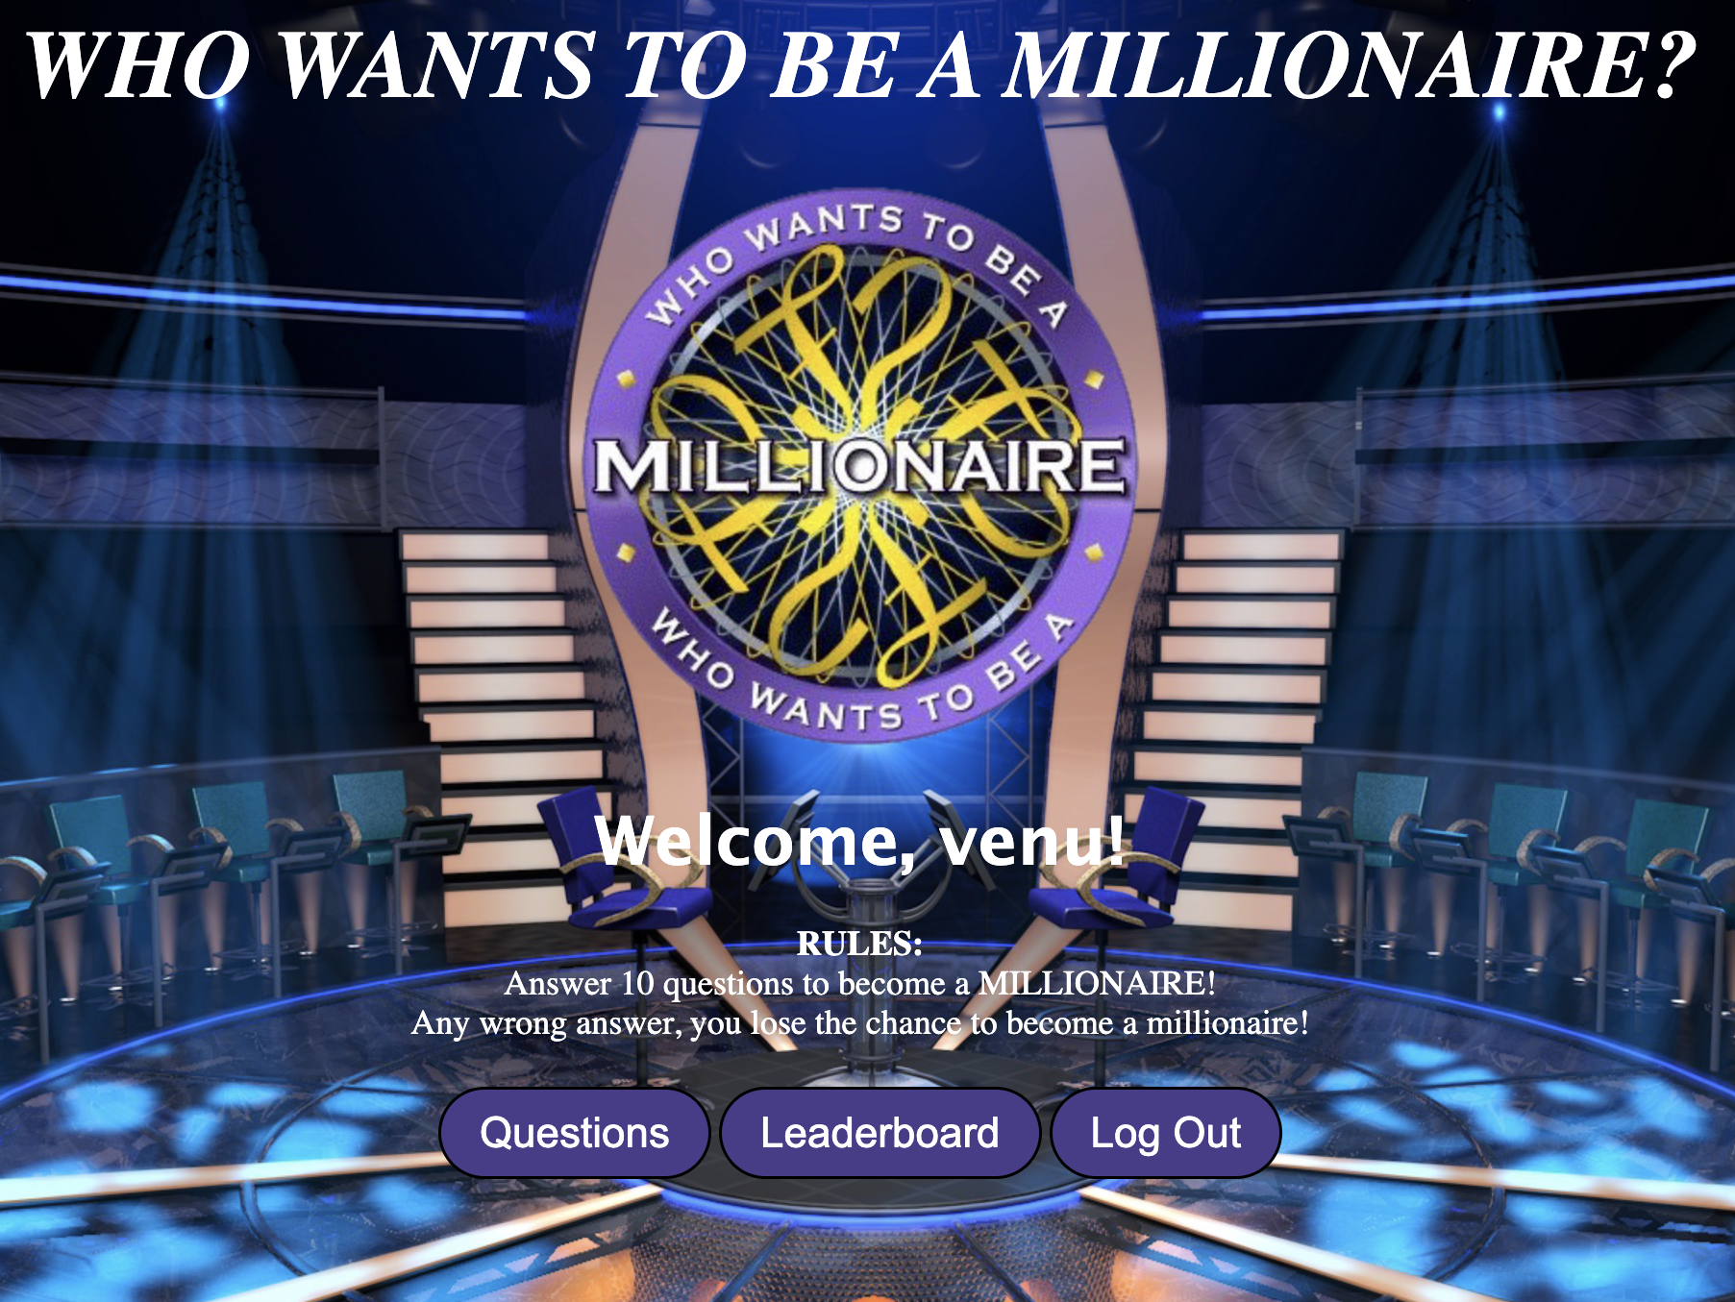
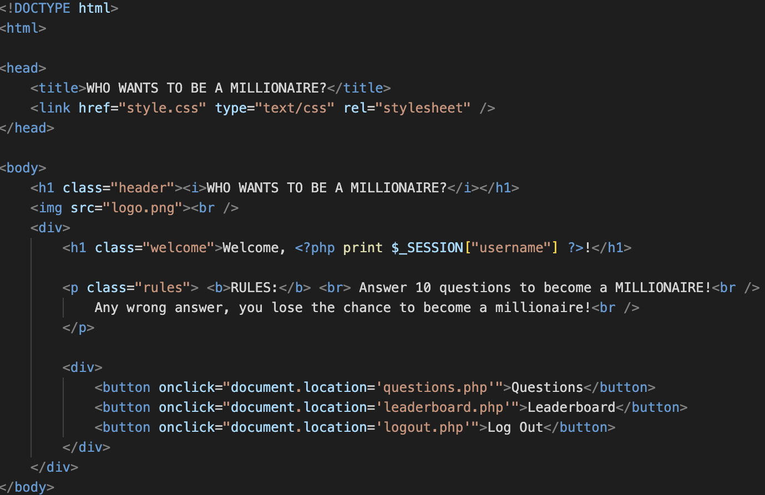

Slide 11
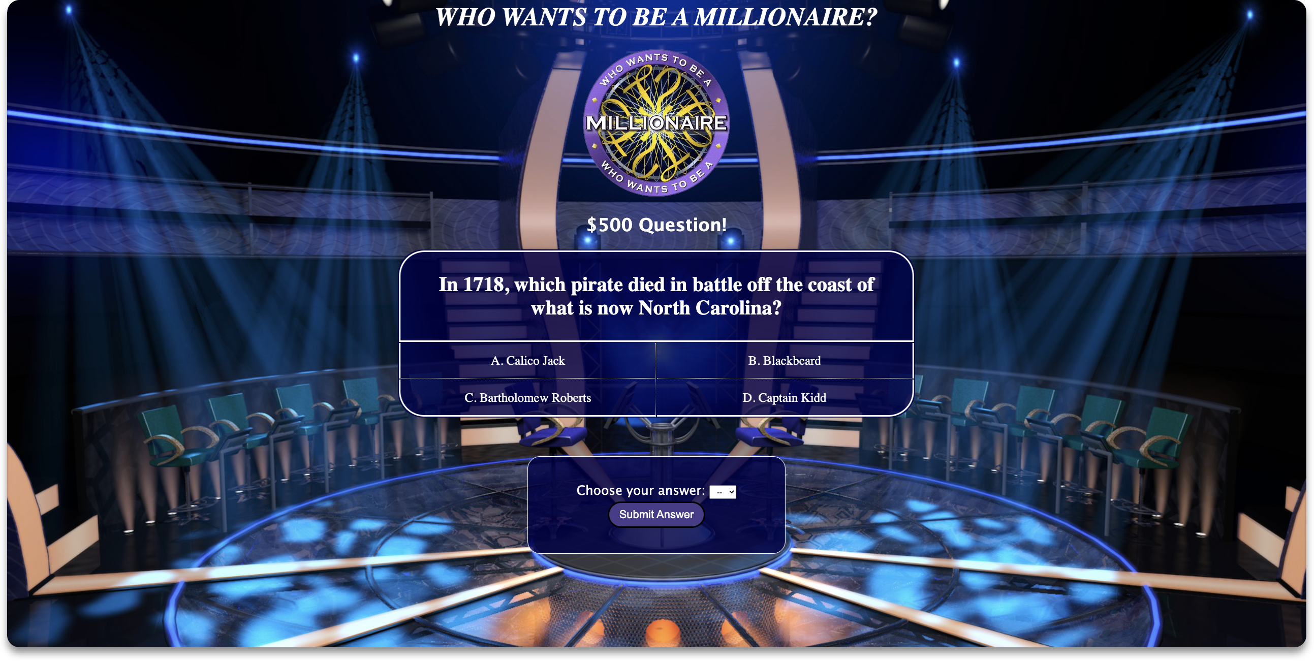

Slide 12
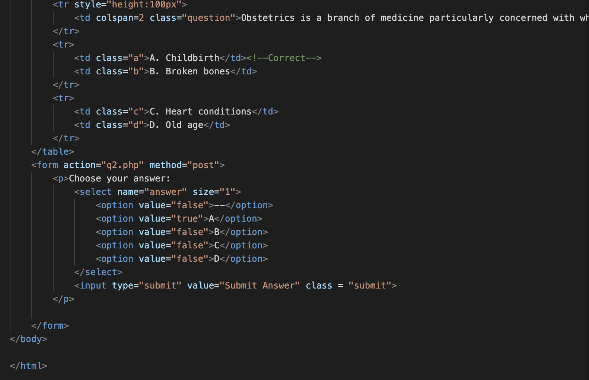

Slide 13
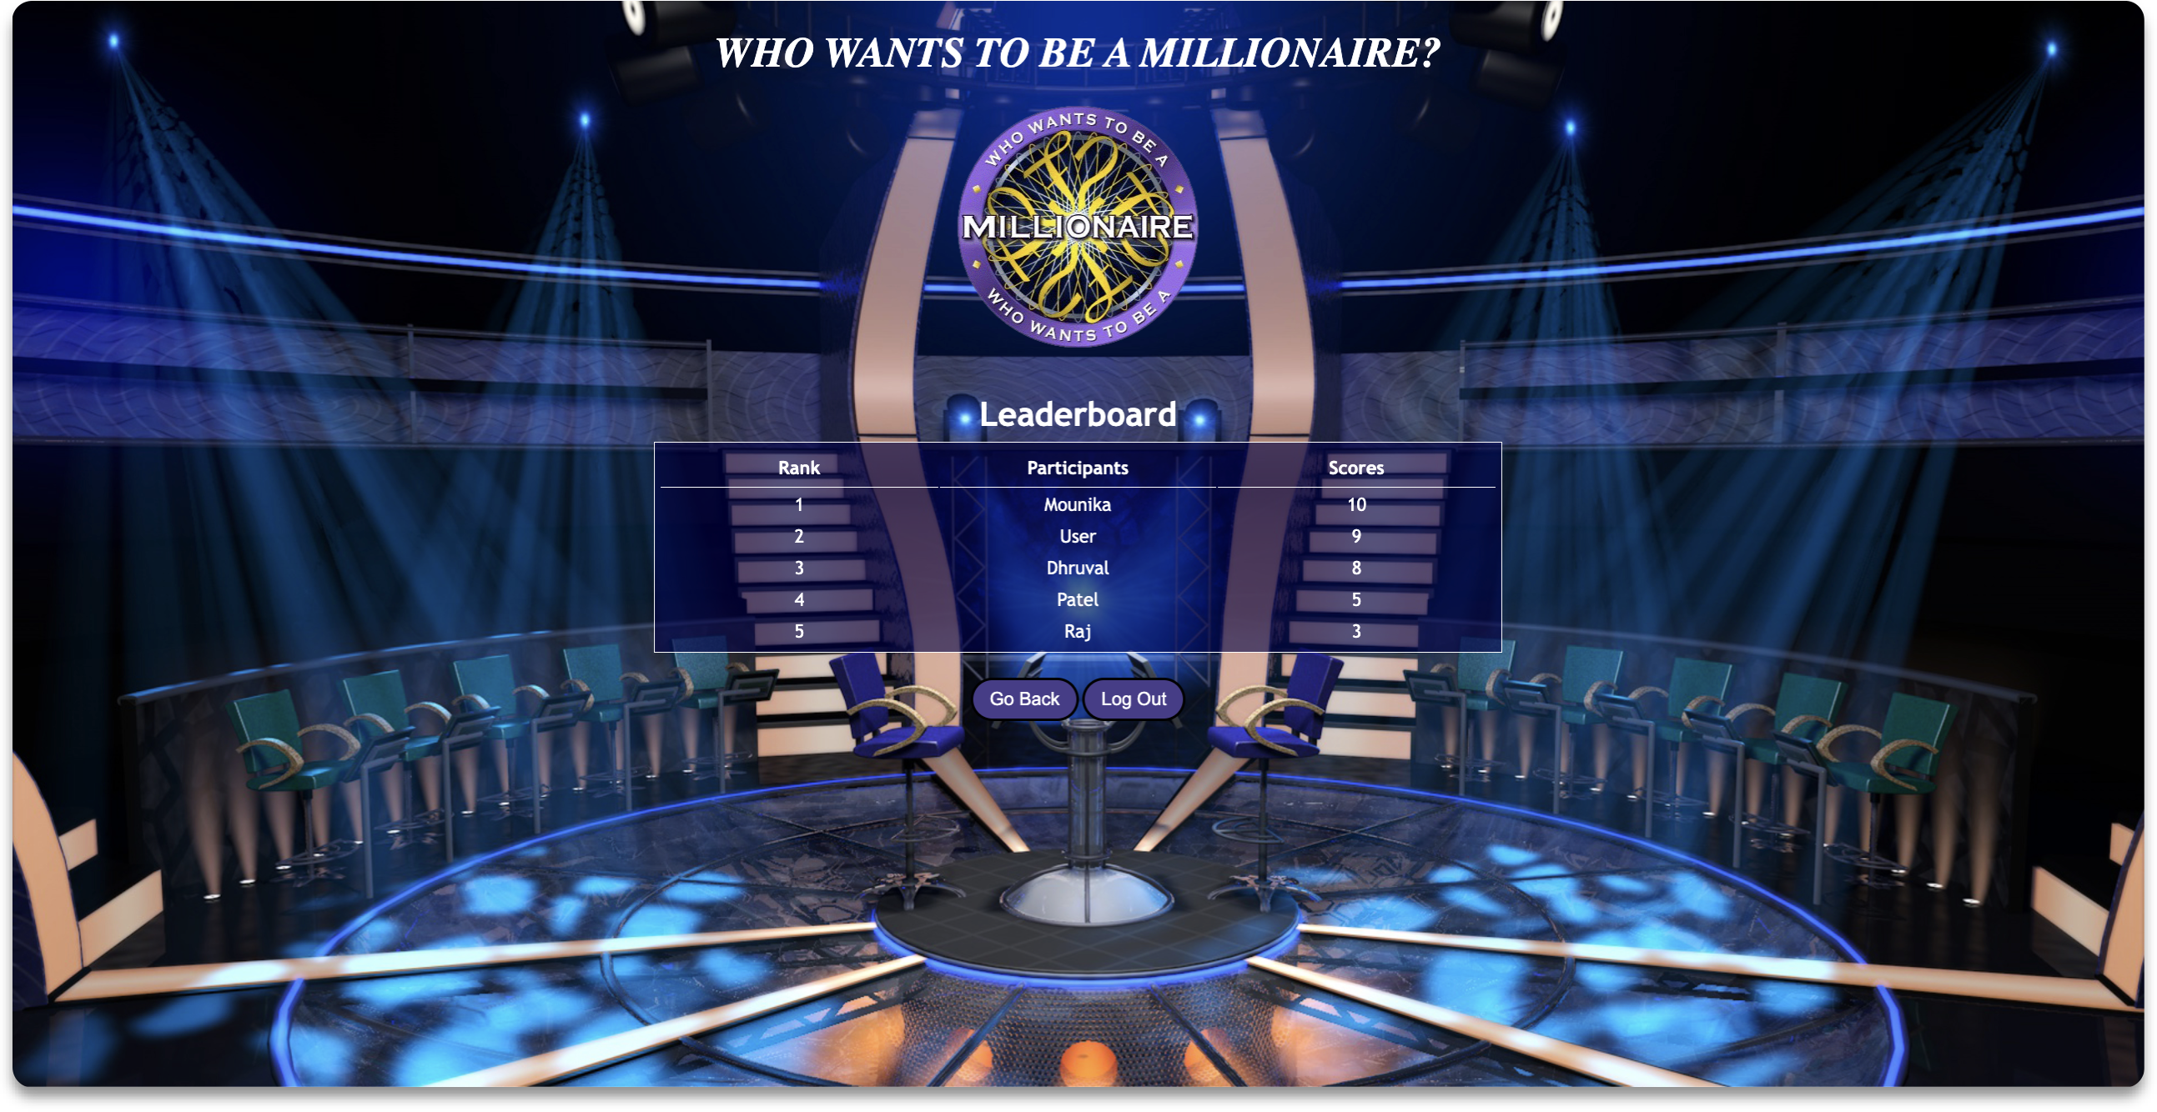

Slide 14
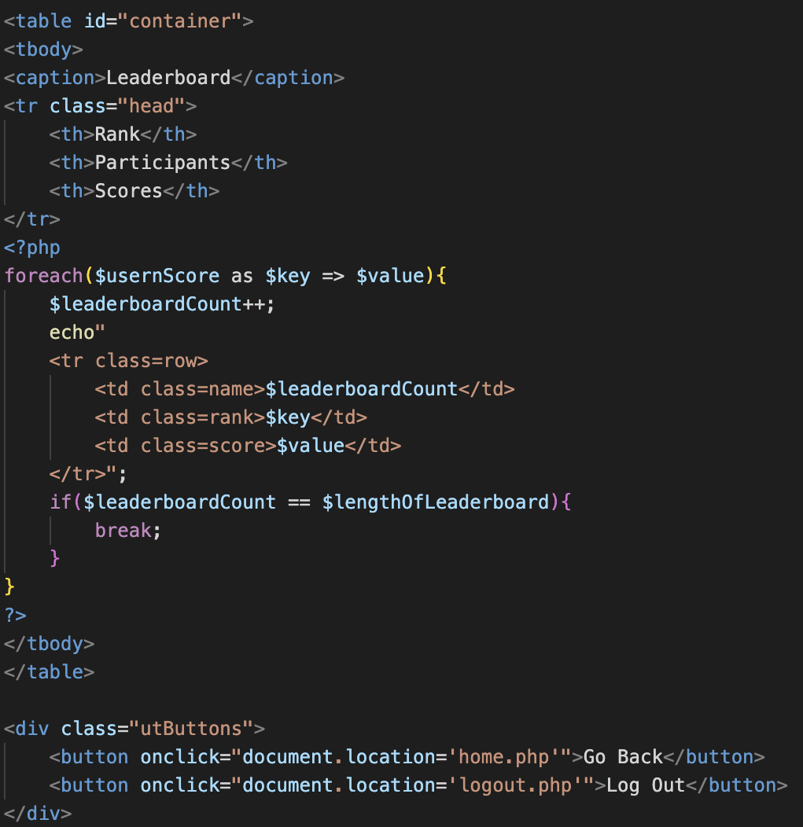

Slide 15


